Slide 1




MINI C COMPILER
Under the guidance of :
Dr. M Karthikeyan
Assistant Professor
Department of Computing Technologies
By:
Utkarsh Saboo (RA2011003011248)
Jatin Singhania (RA2011003011247)

Slide 2

AGENDA
INTRODUCTION
MODULES
FILES
SNAPS OF RESULT
CONCLUSION

Slide 3
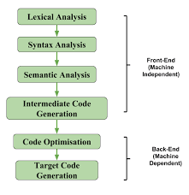
INTRODUCTION
A compiler is a computer program that transforms source code written in a programming language (the source language) into another computer language (the target language), with the latter takes binary form known as object code.
It creates an executable program.
To take a language and convert it to intermediate code.
The part of compiler design is front end which has been made as our mini project.
The Intermediate code generated is independent of machine.

Slide 4
INTRODUCTION
The Mini-Compiler contains all phases of compiler. It has been made by using C language (till intermediate code optimization phase) and we used python language for intermediate code optimization. The constructs that have been focused on are ‘if’, ‘else’ and ‘for’ statements. The final code displays the output of all the phases on the terminal, one after the other. First, the tokens are displayed, followed by a ‘Parse Valid’ message. Then abstract syntax tree is printed. Next, the symbol table along with the intermediate code is printed without optimization. Finally, the symbol table and the intermediate code after optimization is displayed. The final output is the target code. Specific error messages are displayed based on the type of error. Syntax and semantic errors have been handled. The line number is displayed as part of the error message. As a part of error recovery, panic mode recovery has been implemented for the laxer. Languages used to develop this project:
C
YACC
LEX

Slide 5
MODULES
Token, Symbol & Constant Table: This folder contains the code that outputs the tokens and the symbol table.
Intermediate Code Generation: This folder contains the code that generates the symbol table before optimizations and the intermediate code.
ICG Optimized: This folder contains the code that generates the symbol table after optimizations, the quadruples table and the optimized intermediate code.
Target Code: This folder contains the code that displays the assembly code/target code.
Notes:
When conducting research, it is easy to go to one source: Wikipedia. However, you need to include a variety of sources in your research. Consider the following sources:
Who can I interview to get more information on the topic?
Is the topic current and will it be relevant to my audience?
What articles, blogs, and magazines may have something related to my topic?
Is there a YouTube video on the topic? If so, what is it about?
What images can I find related to the topic?

Slide 6
Files
.l : It is the Lexical analyzer file which defines all the terminals of the productions stated in the yacc file. It contains regular expressions.
.y: Yacc file is where the productions for the conditional statements like if-else and while and expressions are mentioned. This file also contains the semantic rules defined against every production necessary. Rules for producing three address code is also present.
.c: C file is where codes as well as tests are written of this format
.sh: UNIX or SHELL powered files which are responsible for running the code in PowerShell and Command Prompt or any Unix based Terminal
Notes:
After consulting a variety of sources, you will need to narrow your topic. For example, the topic of internet safety is huge, but you could narrow that topic to include internet safety in regards to social media apps that teenagers are using heavily. A topic like that is more specific and will be relevant to your peers. Some questions to think about to help you narrow your topic:
What topics of the research interest me the most?
What topics of the research will interest my audience the most?
What topics will the audience find more engaging? Shocking? Inspiring?

Slide 7
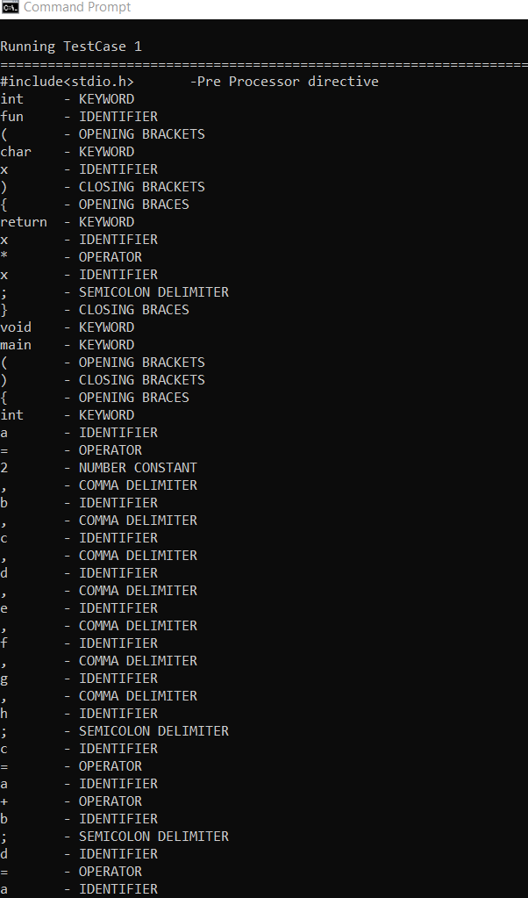
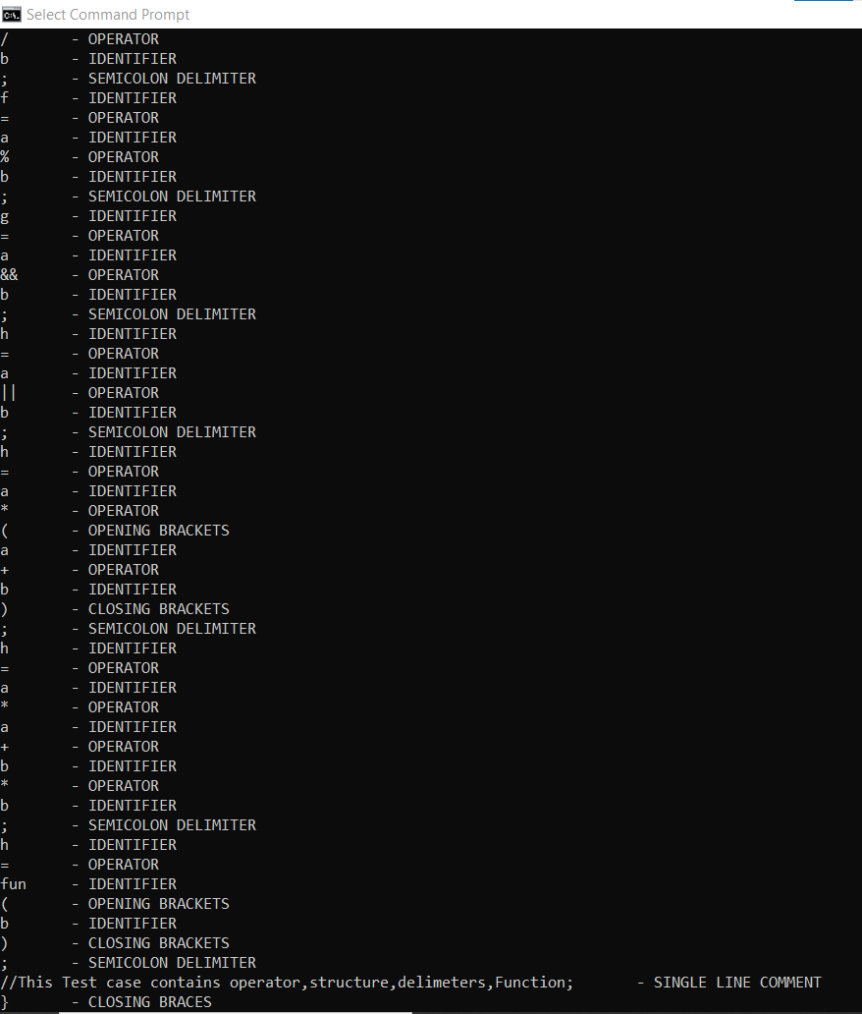
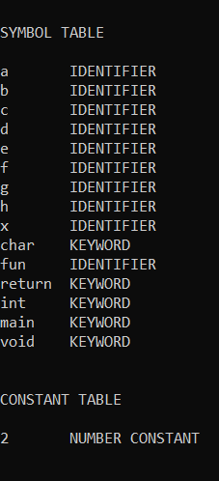
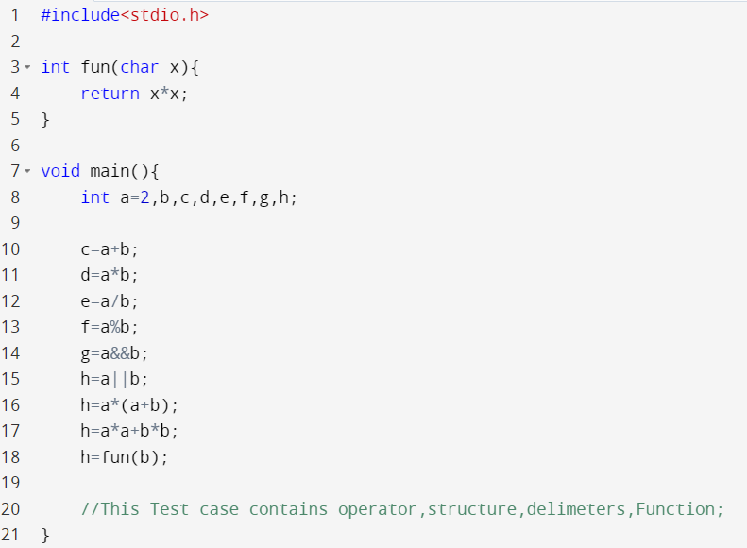
SNAPS OF RESULT
INPUT & OUTPUT – LEXICAL ANALYZER
Notes:
Once you find your sources, you will want to evaluate your sources using the following questions:
Author:
Who is the author?
Why should I believe what he or she has to say on the topic?
Is the author seen as an expert on the topic? How do you know?
Current:
How current is the information in the source?
When was the source published?
Is the information out-of-date?
Accuracy:
Is the content accurate?
Is the information presented objectively? Do they share the pros and cons?

Slide 8
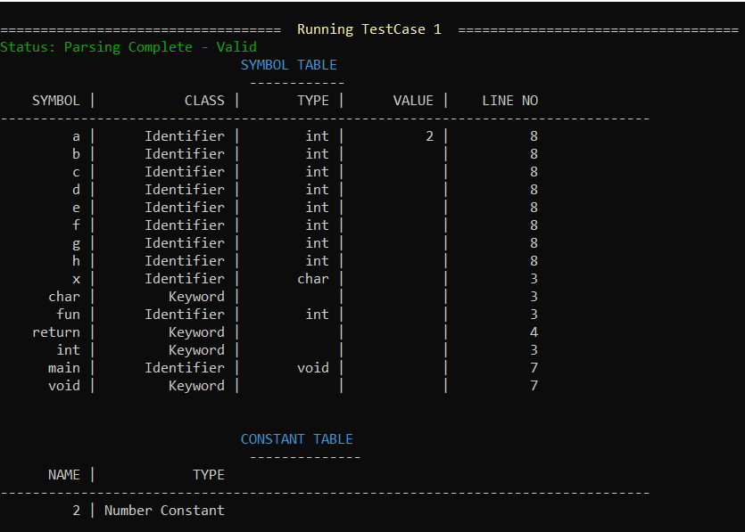
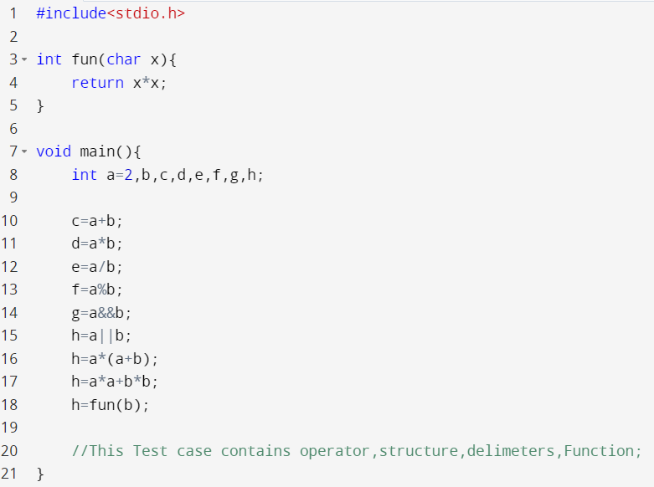
SNAPS OF RESULT
INPUT & OUTPUT – PARSER

Slide 9
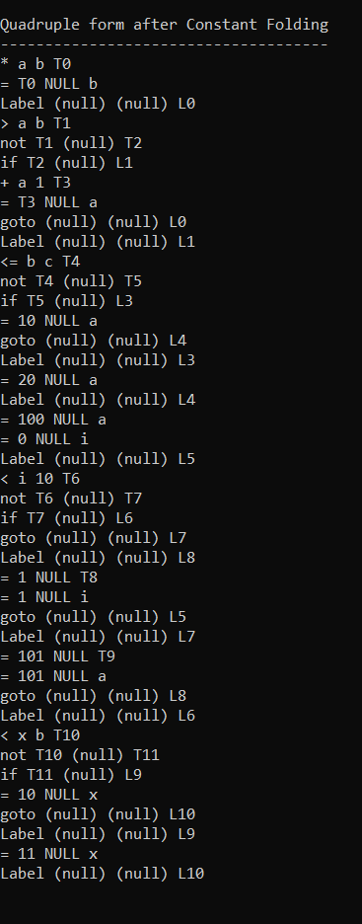
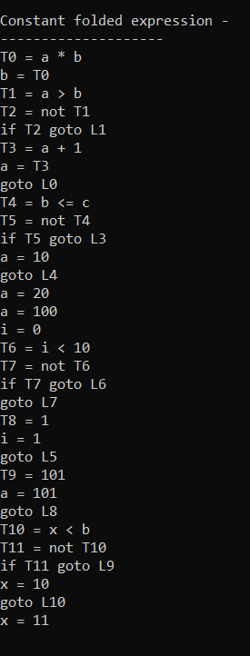
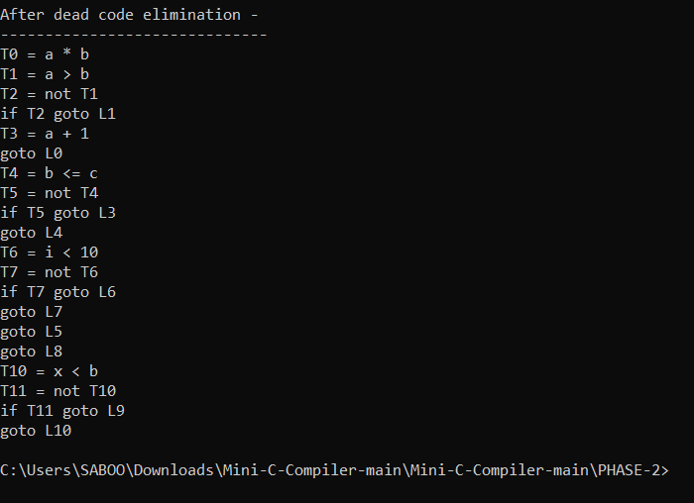
SNAPS OF RESULT
INTERMEDIATE CODE GENERATION

Slide 10
CONCLUSION
In a compiler the process of Intermediate code generation is independent of machine and the process of conversion of Intermediate code to target code is independent of language used.
Making a full fledge compiler is a difficult as well as a tedious task.
Thus we have done the front end of compilation process (Mini Compiler) as our mini project.
It includes 2 phases of compilation:
lexical analysis
syntax analysis
Followed by intermediate code generation.
Notes:
Now, that you have narrowed your topic, you will want to organize your research in a structure that works. There are some common organizational patterns based on the kind of research you are doing.
Organizational Structures:
Cause and Effect- this kind of structure is great for explaining the causes and effects of a topic
Compare and Contrast- in this pattern you highlight the similarities and differences of the topic
Explain process- this structure is great for outlining a series of steps to follow;
Definition- if you want to make sure your audience understands what something is using illustrations, meanings, clarifying misconceptions, you may want to use this structure
Classification- a common organizational structure is grouping like topics or facts from the research together. For instance, in the internet safety about social media apps, you may organize the research where you look at each social media app one at a time

Slide 11


